Slide 1

COMPUTER APPLICATIONS
Dr. Tanmoy Dhibor
Assistant Professor
Hooghly Women’s College

Slide 2
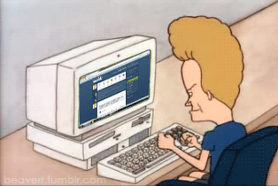
Definitional view:
“A Computer is an electronic machine that can solve different problems, process data, store & retrieve data and perform calculations faster and efficiently than humans”.
--Charles Babbage

Slide 3
Computer: Basic Operations
INPUT
PROCESSING
OUTPUT
STORAGE

Slide 4
Computer: Five Elements
Hardware
Software
    System Software i.e. mainly operating system.
    Application Software
Humanware
Data
Procedure

Slide 5
Internet: Overview
The history of the Internet begins with the development of electronic computers in the 1950s. Initial concepts of wide area networking originated in several computer science laboratories in the United States, United Kingdom, and France.
Commercial Internet service providers (ISPs) began to emerge in the very late 1980s.
In the 1980s, British computer scientist Tim Berners-Lee resulted in the World Wide Web, linking hypertext documents into an information system, accessible from any node on the network.
A Web 2.0 website may allow users to interact and collaborate with each other in a social media dialogue as creators of user-generated content in a virtual community, in contrast to the first generation of Web 1.0-era websites where people were limited to the passive viewing of content.

Slide 6
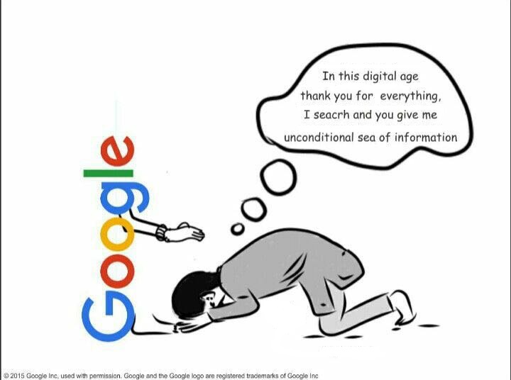
WWW: Concept
The World Wide Web (WWW), also called the Web, is an information space where documents and other web resources are identified by Uniform Resource Locators (URLs), interlinked by hypertext links, and accessible via the Internet.^{[1]} English scientist Tim Berners-Lee invented the World Wide Web in 1989.

Slide 7
Internet: Powered by (Any)⁶
Any User
Any Where
Any Time
INTERNET
Any Information
Any Language
Any Format

Slide 8
Web 2.0
“WEB 2.0 IS AN ATTITUDE NOT A TECHNOLOGY”
~~IAN DAVIS, 2005

Slide 9

Services, not packaged software.
Control over unique, hard-to-recreate data sources that get richer as more people use them
Trusting users as co-developers
Harnessing collective intelligence
Participation and customer self-service
Lightweight user interfaces, development models, AND service models
Source: O’Reilly

Slide 10
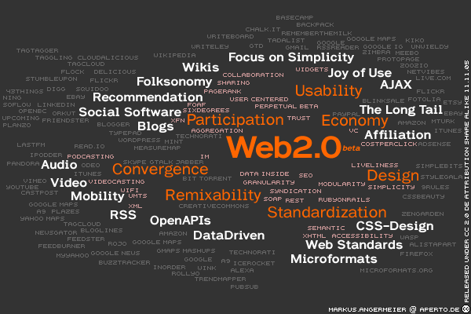

Slide 11
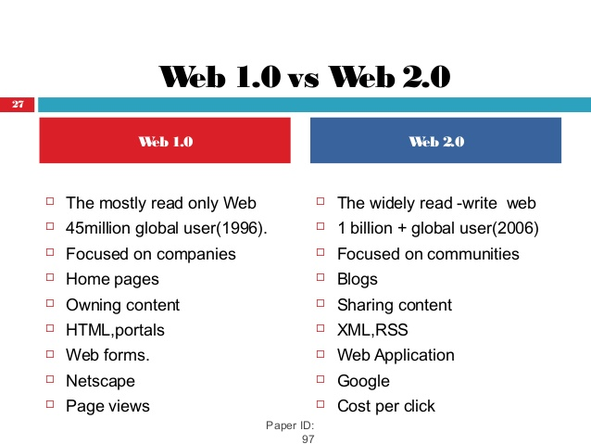

Slide 12
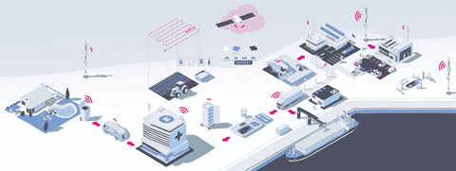
Internet of Things
The term "The Internet of Things" was coined by Kevin Ashton in a presentation to Proctor & Gamble in 1999.The internet of things (IoT) is a computing concept that describes the idea of everyday physical objects being connected to the internet and being able to identify themselves to other devices. IoT describes a world where just about anything can be connected and communicate in an intelligent fashion. In other words, with the internet of things, the physical world is becoming one big information system.

Slide 13
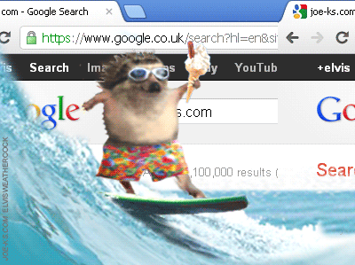
Internet Surfing: Concept
Internet surfing is the Web definition. To navigate through the World Wide Web or Internet, usually by clicking with a mouse. The term also has a generic meaning of spending time on the Internet. That means search anything on the internet.

Slide 14
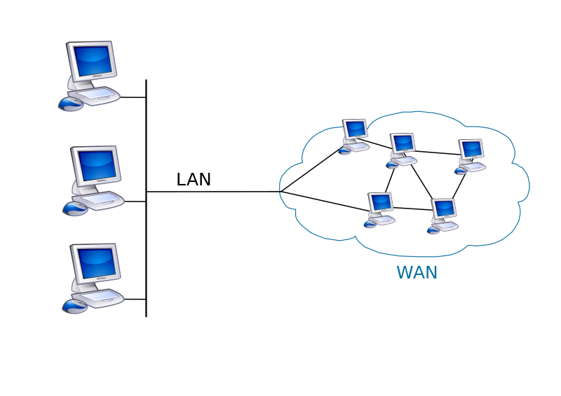
Internet Services By Scale
LAN: A local area network (LAN) is a group of computers and associated devices that share a common communications line or wireless link to a server.
MAN: A metropolitan area network (MAN) is a computer network that interconnects users with computer resources in a geographic area or region.
WAN: A wide area network (WAN) is a telecommunications network or computer network that extends over a large geographical distance/place. Wide area networks are often established with leased telecommunication circuits.

Slide 15
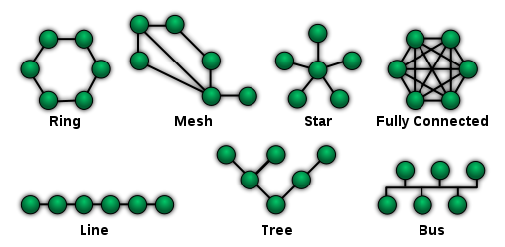
Network Topology:
Network topology is the arrangement of the elements (links, nodes, etc.) of a communication network. It is the topological structure of a network and may be depicted physically or logically.

Slide 16
How To Access The Internet ?
Many schools and businesses have direct access to the Internet using special high-speed communication lines and equipment.
Students and employees can access through the organization’s local area networks (LAN) or through their own personal computers.
Another way to access the Internet is through Internet Service Provider (ISP).
To access the Internet, an existing network need to pay a small registration fee and agree to certain standards based on the TCP/IP (Transmission Control Protocol/Internet Protocol) reference model.
Each organization pays for its own networks and its own telephone bills, but those costs usually exist independent of the internet.
The regional Internet companies route and forward all traffic, and the cost is still only that of a local telephone call.

Slide 17
Internet Service Provider (IPS)
It refers to a company that provides Internet services, including personal and business access to the Internet. In 1990s, there ware four types of IPSs:
PC-dialup services (through Modem),
High-speed Internet (through Broadband)
Digital Line Subscribers (through Phone companies)
Others ( Web TV, Cable TV).

Slide 18
Addresses on the Web: IP Addressing
Each computer on the internet does have a unique identification number, called an IP (Internet Protocol) address.
The IP addressing system currently in use on the Internet uses a four-part number.
Each part of the address is a number ranging from 0 to 255, and each part is separated from the previous part by period,
For example, 106.29.242.17

Slide 19
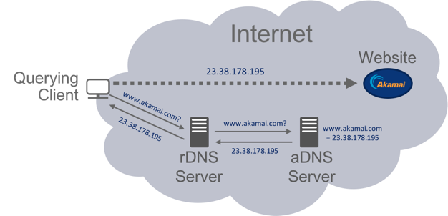
Domain Name System (DNS)
A domain name is a unique name associated with a specific IP address by a program that runs on an Internet host computer.
This allows local control of the overall database, and yet the data in each small segment is available across the entire network.

Slide 20
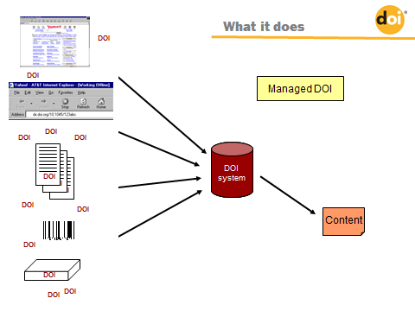
Digital Object Identifier (DOI)
A DOI (Digital Object Identifier) is a unique alphanumeric identifier applied to a specific piece of intellectual property, particularly one presented in an online environment -- be that object a book, a scientific paper, a song, an image, or something else.

Slide 21
Uniform Resource Locator (URL)
Uniform Resource Locator (URL) – this type of URI begins by stating which protocol should be used to locate and access the physical or logical resource on a network. If the resource is a web page, for example, the URI will begin with the protocol HTTP. If the resource is a file, the URI will begin with the protocol FTP or if the resource is an email address, the URI will begin with the protocol mailto. It is important to remember that URLs are not persistent. This means that if the resource’s location changes, the URL also needs to change to point to the resource’s new location.

Slide 22
Structure of a Uniform Resource Locators
Protocol
Pathname
http://www.buruniv.ac.in/download/SyllabusEnglish.pdf
Domain name
Filename
http => Hypertext Transfer Protocol

Slide 23
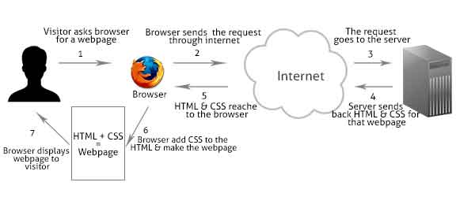
WWW: How it Works ?
W3 is an interlinked collection of hypertext documents (which includes text, graphics, sound and other multimedia elements), called web pages. Web browser run as client software at the user terminal contacts Web server and requests information. The Web server locates and then sends the information to the web browser, which displays the results.

Slide 24

Web Search Tools: Search Engine
These tools automatically index web resources by sending robots or crawlers (programmes that find & send web pages to the server of search engines) to the web. Some popular examples includes…
Google (https://www.google.com/)
Altavista (http://www.alvista.com/)
Yahoo (https://in.yahoo.com/)
ASK (http://ask.com/)
Bing (https://www.bing.com/)
LiveSearch (http://live.com/)
Gigablast (http://gigablast.com/)

Slide 25
Web Search Tools: Subject Directory
These tools provides services related to retrieval of web pages by the help of human indexer. A group of human indexer finds, evaluates and finally places web pages under various categories (e.g. Science>Life Science> Zoology) for easy access and retrieval of web pages by the searchers. Examples includes…
Intute – Social Science (http://www.intute.ac.uk/)
SciCentral – Science (http://scicentral.com/)
Voice – Humanities (http://vos.ucsb.edu/)
Google directory (http://directory.google.com/)
Open directory project (http://dmoz.org/)

Slide 26
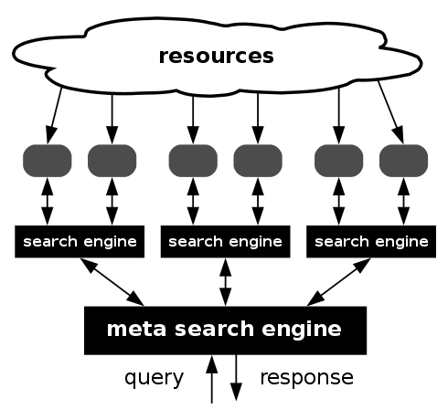
Web Search Tools: Meta Search Engine
These search engines are designed to send quaries to selected search engines and retrieve results sets from search engines. Finally, after checking duplications from various results sets (retrieved from different search engines), these tools prepare final result set for searchers.
Mamma
Dogpile
Clusty
Ixquick
Metacrawler

Slide 27
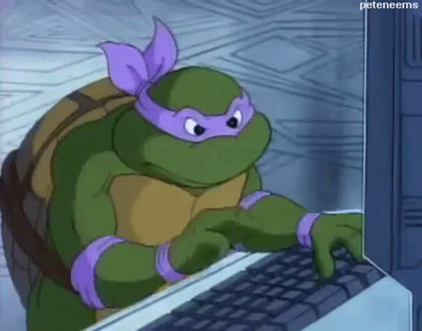
Search Operators
A search process starts with the identification of essential words or concepts relevant to topic(s) of search such as key terms, subject terms, and topic headings. Searchers should also consider the words, terms, and phrases that database compilers, editors, indexers, authors, and other subject specialists are likely to have used when describing the search topic.

Slide 28
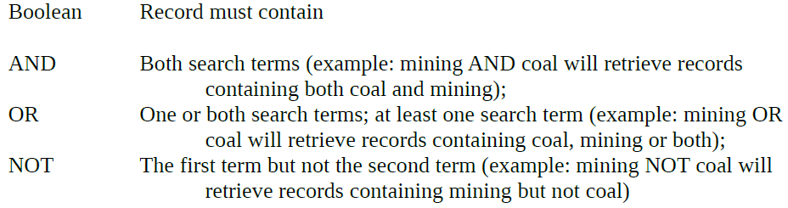
Search Operators: Boolean Operators
These search operators help addition of concepts (AND), separation of concepts (NOT) and inclusion of concepts (OR). On the basis of use of these three operators, Boolean searching may be grouped as – Simple (use of only type of Boolean operator in a single search statement), Compound (use of more than one type of Boolean operators in a single search statement), and Nested (use of multiple parentheses to specify order of processing in a compound Boolean search).

Slide 29
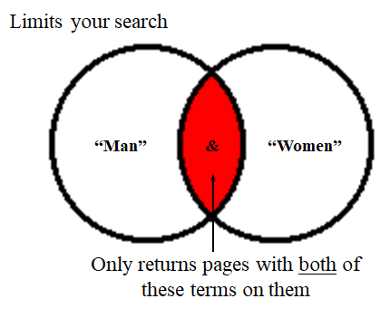
Boolean Logic : AND

Slide 30
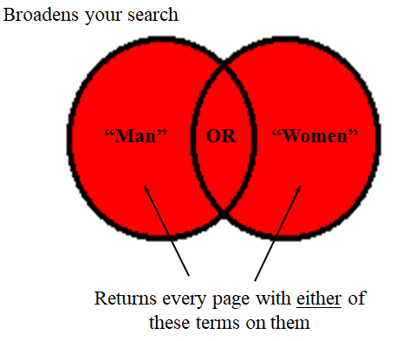
Boolean Logic : OR

Slide 31
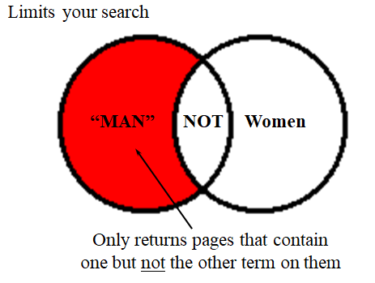
Boolean Logic : NOT

Slide 32
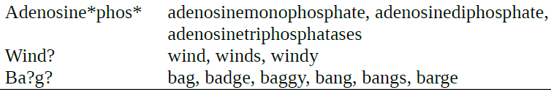
Search Operators: Truncation Search
These technique supports retrieval of different forms of a term but all with one part in common. There are many truncation symbols that are in use in different search engines such as *, $, % and ?. Truncation is of three types – Prefix (left truncation), Infix (middle truncation) and Suffix (right truncation). Examples are –

Slide 33
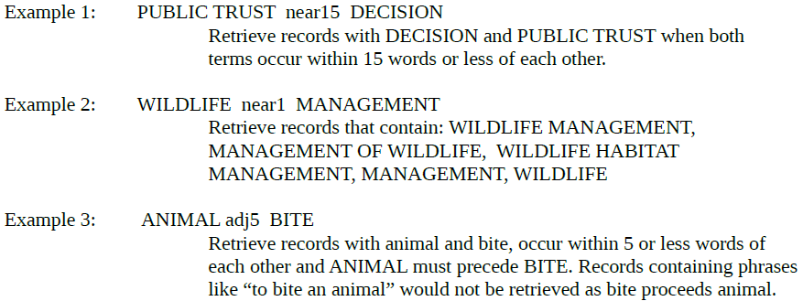
Search Operators: Proximity Operators
These operators help to specify distance between two search terms precisely. A proximity search is a search of two words, which occur near, but not necessarily next to each other. In proximity search various operators are WITH or ADJ operator and NEAR operator.

Slide 34
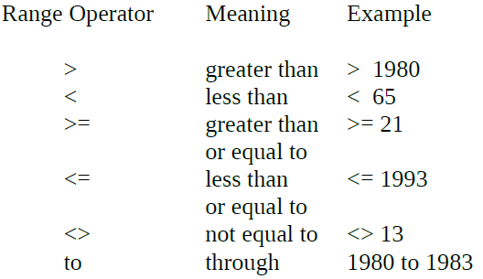
Search Operators: Range Search
It helps in selecting/filtering records within certain data ranges. Users can specify an alpha or numeric range to a search (for instance, to confine search to a particular year or range of years). Range searching is most useful in the Advanced or Expert search modes, where fields can be searched individually.

Slide 35
Search Operators: Phase Search
Phrase search is one particular application of proximity searching. For example, the WITH or ADJ operator can accomplish the exact phrase search. The retrieve records, in a phrase search, contain the phrase i.e. the words in the phrase next to each other. Example –
“FIRE ENGINE”
Retrieve records including FIRE ENGINE. Also searches ENGINE FIRE if word order is varied.

Slide 36
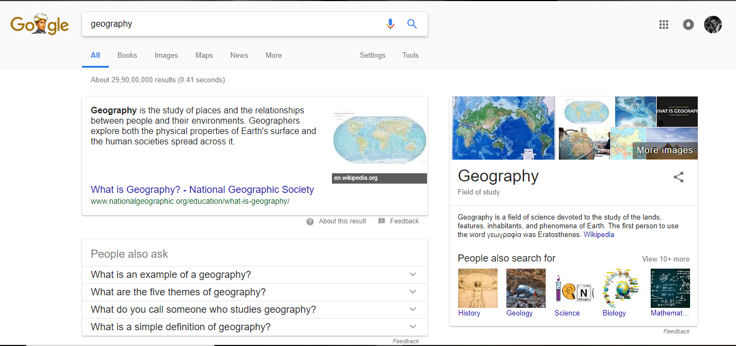
Simple Information about search
Search Box
Filter Results
Information Display

Slide 37
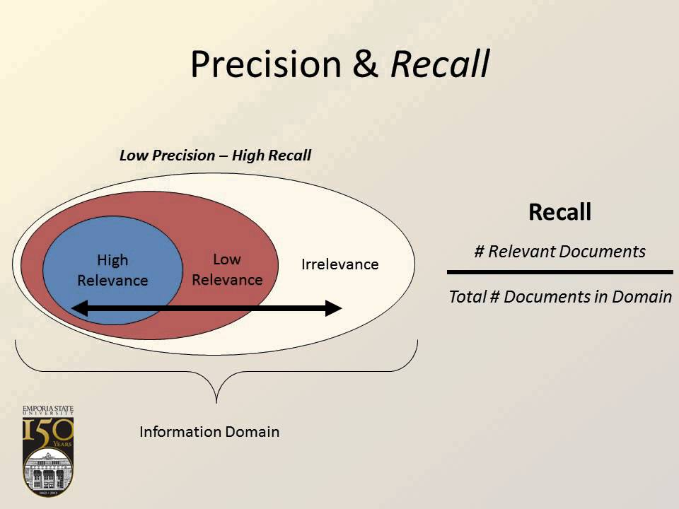
Recall and Precision
In information search, recall is the fraction of the relevant documents that are successfully retrieved.
In the field of information search, precision is the fraction of retrieved documents that are relevant to the query:

Slide 38
Google Special Keywords for Searching: From broader to narrower
2
3
allintitle: "Geography of india" filetype:pdf site:in
1
4
Documents name
Searching the title of the documents
3. File type of document (PDF/PPT/Word/HTML)
4. Country wise documents availability.

Slide 39
Academic Searching Tools
Google Scholar (https://scholar.google.co.in/)
DOAJ (https://doaj.org/)
BASE (https://www.base-search.net/)
Academia.edu (https://www.academia.edu/)
Research Gate (https://www.researchgate.net/)
Public Library of Science (https://www.plos.org/)
Shodhganga (http://shodhganga.inflibnet.ac.in/)
Shodhgangotri (http://shodhgangotri.inflibnet.ac.in/)

Slide 40
E-Books
NDLI (https://ndl.iitkgp.ac.in/)
DOAB (https://www.doabooks.org/)
Google books (https://books.google.co.in/)
OpenLibrary (https://openlibrary.org/)
Dept. of School Education, WB (http://www.wbsed.gov.in/wbsed/default.html)
Project Gutenberg (https://www.gutenberg.org/)
NCERT (http://www.ncert.nic.in/index.html)
eBasta (https://www.ebasta.in)
Internet Archive (https://archive.org/)

Slide 41
